Slide 1

How Data & AI can help detect Methane emissions
Centrale - Essec
Tech Challenge
Mai, 2023

Slide 2

Agenda
Day
Time
Activity
Friday 12 May
ESSEC Campus
16h30-17h30
Tech challenge presentation and Q&A
Week-end / Monday
N.A
Team work – Including coaches support
Tuesday 16 May
McKinsey XP Studio
18h-18h30
Welcome and introduction
18h15-20h
Team presentations – 9 x 10
20h-20h30
McKinsey approach to Methane emissions
20h30
Challenge results and award sharing
QuantumBlack, AI by McKinsey
2

Slide 3

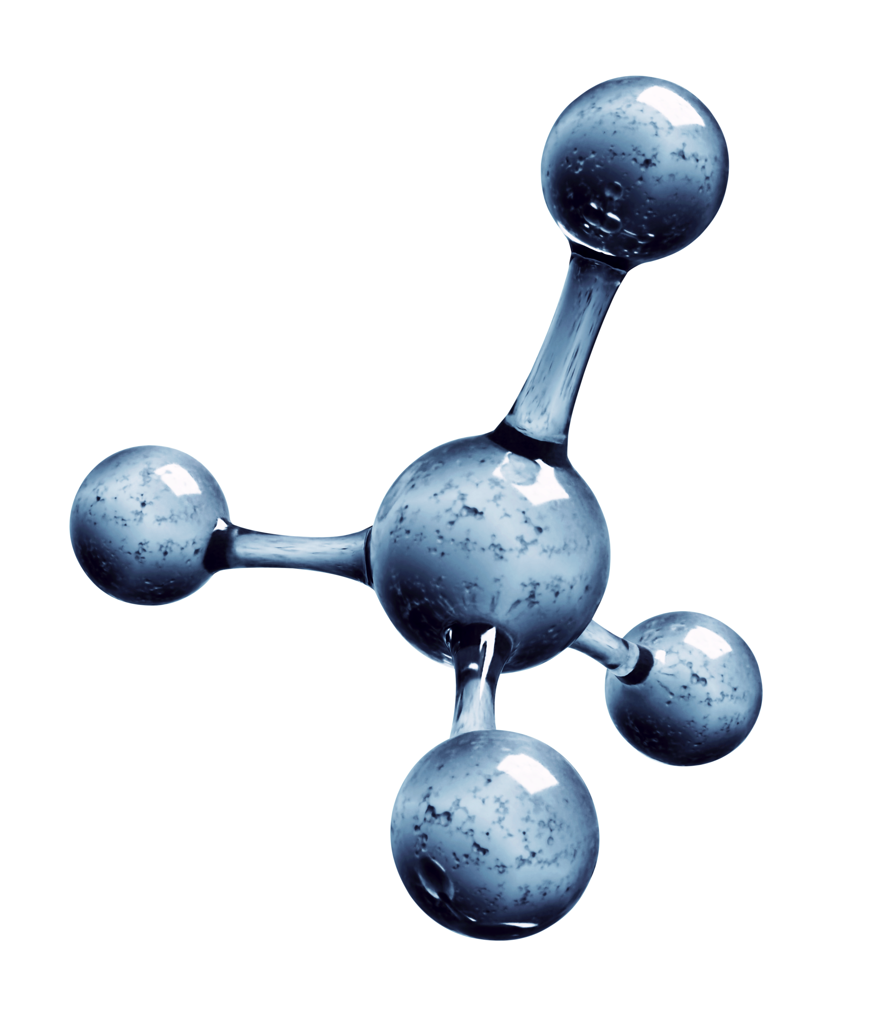
CleanR
At CleanR, we’re a fast-growing start-up specialized in Methane emissions reporting. Our founders team met for the first time in 2020 in Geneva. Today, we count already 50 team members.
Our mission is to help diminish Methane emissions by providing a clear method for MRV: monitoring, reporting and verification.
Three ingredients are crucial to our work: our talented people, satellite images and deep learning!
CleanR CoE and Co-founder

Slide 4



Announcement
Reda
We are hiring a new data science team to help us localize methane leaks in the atmosphere.
We have already gathered satellite images [data set – 64 x 64 images in greyscale] of different locations, and we need to identify whether each location contains a methane plume or not.
We also want the team to help us find use cases where this model can be used to drive positive impact.
CleanR Chief Analytics Officer
Example of satellite image with a plume of methane

Slide 5





To help CleanR, please provide ...
Reda
Predicted labels for the test set [csv file]
Model code [Github link or zip file]
Code of your web app including at least 2 features:
Uploading satellite images
Code execution to determine whether it contains plumes of methane
Pitch presentation [PPT – 10 mns]
Scientific approach
Web App demo. If you didn’t develop a web app, you can present a mock-up instead.
How are you going to use your app to drive positive impact ?
/!\ DO NOT change images names

Slide 6




CleanR mindset
Reda
THINK BIG and start small!
BE CREATIVE!
BE INCLUSIVE!
HAVE FUN!

Slide 7
Grading criteria
Mathilde
Type
Axis
Criteria
Tech
Modeling
Model performance
Scientific approach quality and depth
Code quality (typing, docstring, comments, code clarity)
App
Did the team build an MVP (minimum viable product) ?
Creativity
User experience (ergonomy, ease of use for standard user)
Business
Pitch
The pitch was structured, impact driven and dynamic
Business model
Did the team understand the business aspect of methane emissions ?
Relevance of use cases to drive positive impact with the web app ?
Business model elements

Slide 8
Teams and Coaches
Mathilde
Team #
Coach data
1
Sophie Brosse, sophie_brosse@mckinsey.com
2
Mathilde Lavacquery, mathilde_lavacquery@mckinsey.com
3
Othmane Aitboumlik, Othmane_Aitboumlik@mckinsey.com
4
Emma Milliot, Emma_milliot@mckinsey.com
5
Colomban Basset, Colomban_basset@mckinsey.com
6
Lucie Gattepaille, Lucie_gattepaille@mckinsey.com
7
Amine Dassouli, amine_dassouli@mckinsey.com
8
Marwa Mahfoud, Marwa_mahfoud@mckinsey.com
9
Louise Bouton, louise_bouton@mckinsey.com
10
Sasha Collin, sasha_collin@mckinsey.com

